Slide 1
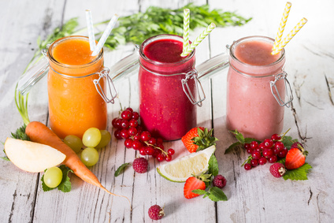
Shaklee Smoothie Workshop
Hosted by Moyra Gorski and Pam Cary

Slide 2
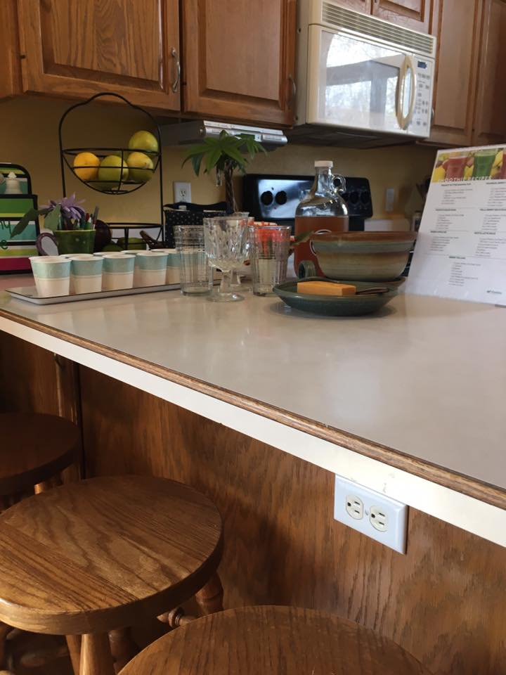
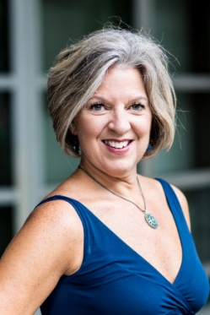
Welcome to our Virtual Smoothie Workshop
Your hosts:
Moyra Gorski Pam Cary
Please have a make-believe seat on the bar stools and enjoy a few minutes as we get ready to share some delicious smoothies (virtually), using Shaklee Life Shakes.
While you are relaxing, Pam and I would like to share our stories with you, so you can get to know us a bit better.
M

Slide 3
Moyra’s Shaklee Story
RN and Medical Sales Rep.
Searching for help for son with allergies/asthma
Made some changes and everyone's health improved.
Started sharing what I was learning & helped others and business began
Love not having to trade time for $$
Helping others reclaim their health & life
Freedom, Flexibility, Leadership & Travel!

Slide 4
Pam’s Shaklee Story
Raised on Shaklee products
Former Corporate Buyer for Aldi
Left corporate job with 6-figure income to raise 5 kids
Love helping others learn & earn
22 years later – earning $$, trips, love the community
Scalable, ownable, inheritable business; building a legacy

Slide 5
The Shaklee Difference
SAFE
PROVEN
GUARANTEED
350
tests against harmful contaminants
100+
Patents and published scientific papers
146
Gold, Silver and Bronze Medals from The Games
All products are
100%
guaranteed
P

Slide 6
Why is Protein Important??
Building blocks of healthy cells
Essential macronutrient that helps build muscle, repair tissue, and make enzymes and hormones.
The DRI (Dietary Reference Intake) is 0.36g/pound of body weight. Sedentary average man = 56g; sedentary average woman= 46g. Increased activity=more protein.
P

Slide 7
Why Life Shake?™
Life Shake is Powered by Leucine®, the most effective branched chain amino acid for:
Preserving muscle mass
Helping to burn fat
Aids in weight loss (or gain)
Improve metabolism
Reducing cravings
Life Shake is also clinically proven to support healthy blood pressure and healthy blood sugar levels.
P

Slide 8
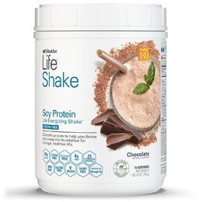
Peanut Butter Banana Cup
Fan favorite
Breakfast or Dessert
Bananas: Fresh or Frozen
2 scoops Shaklee Life Shake Chocolate
½-1 banana
1 Tbsp. Natural PB or PB2 powder
1 Tbsp. Dark Cocoa Powder (opt.)
8 oz. milk or water
4-6 ice cubes (optional)
M

Slide 9
Cauli-Berry Delicious Smoothie: Freezer Ready
Berry-licious
Full of antioxidants
Berries have anti-inflammatory properties, anti-bacterial, anti-viral
2 scoops Shaklee Strawberry Life Shake
½ cup Raspberries
½ cup Blueberries
¼ cup cauliflower rice
8 oz. milk or water
4-6 ice cubes (optional)
P

Slide 10
Organic Greens Booster
Provides one cup of raw, organic, nutrient-rich green vegetables in every scoop, making it easy to get the vegetables often missed in meals.
Contains dehydrated kale, spinach and broccoli in their purest form, with all the fiber intact.
Add one scoop or more to your favorite Life Shake and try it in foods such as soups, stews or pasta.
M

Slide 11
It starts with a simple challenge…
P

Slide 12
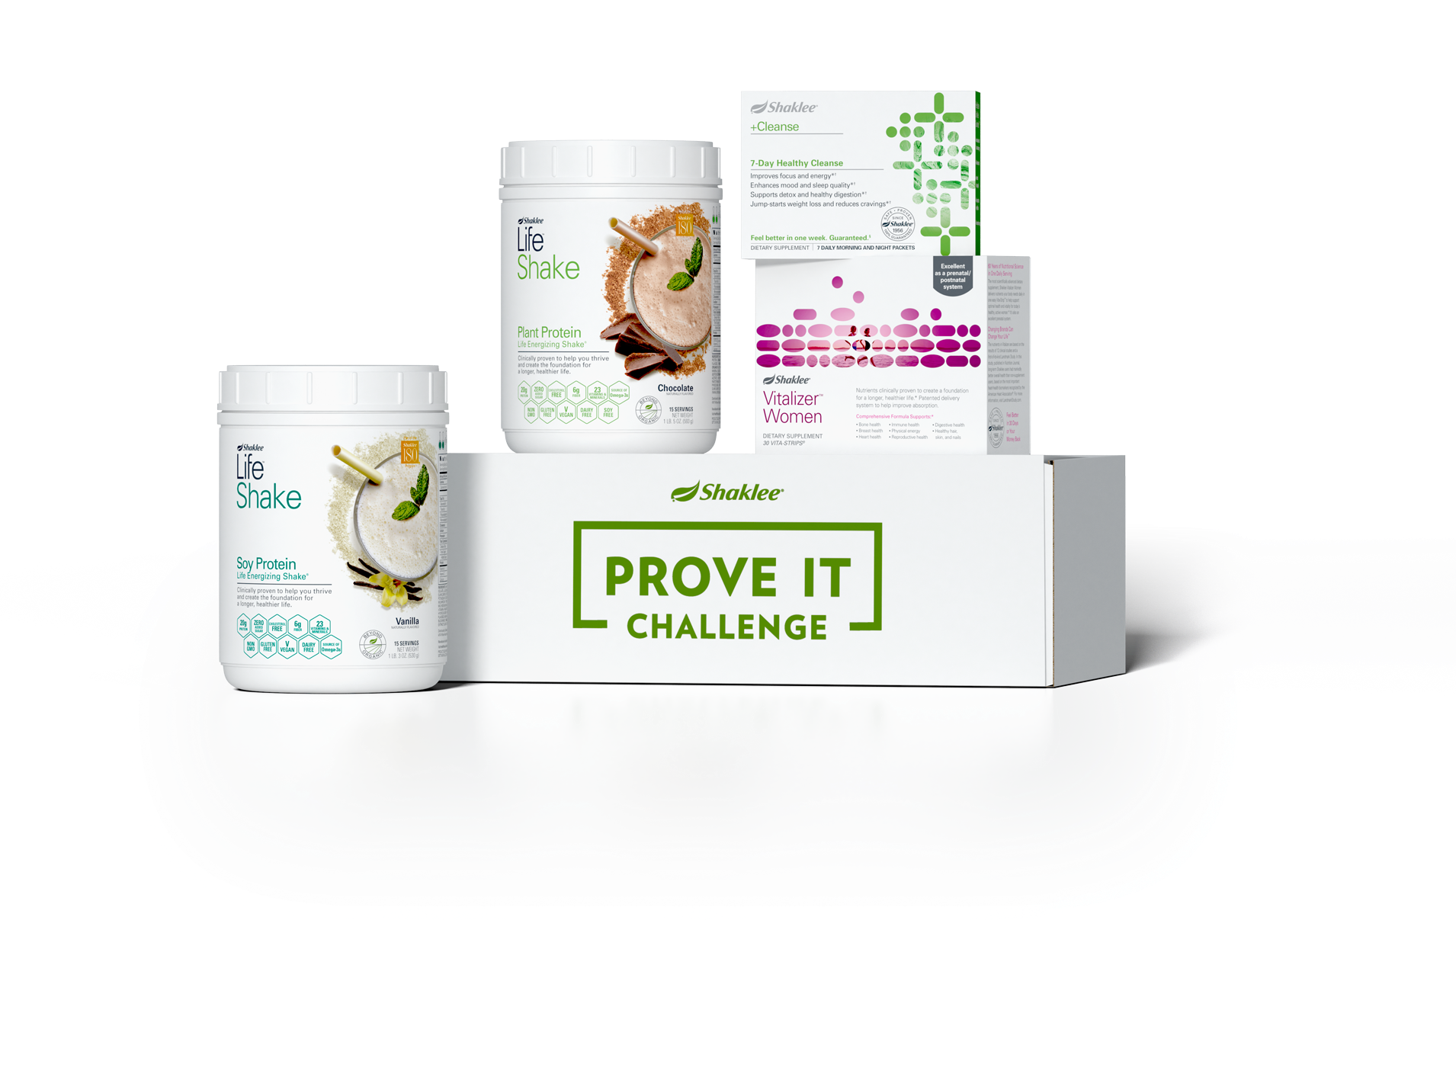
Prove It Challenge Kit
Includes 30 Vitalizer Strips, 30 Life Shakes and a FREE 7-day Healthy Cleanse Kit.
#89544 | SPECIAL PRICE $159 Includes Free Shipping and Free Shaklee Membership.
First Time Purchase Only.
P
Notes:
EDITS: Move Shaklee logo to page one from this page – no logo here
Where does that movement start?
It starts with your own health.... Step one.... we invite you to take our 30 Day Prove It Challenge

Slide 13
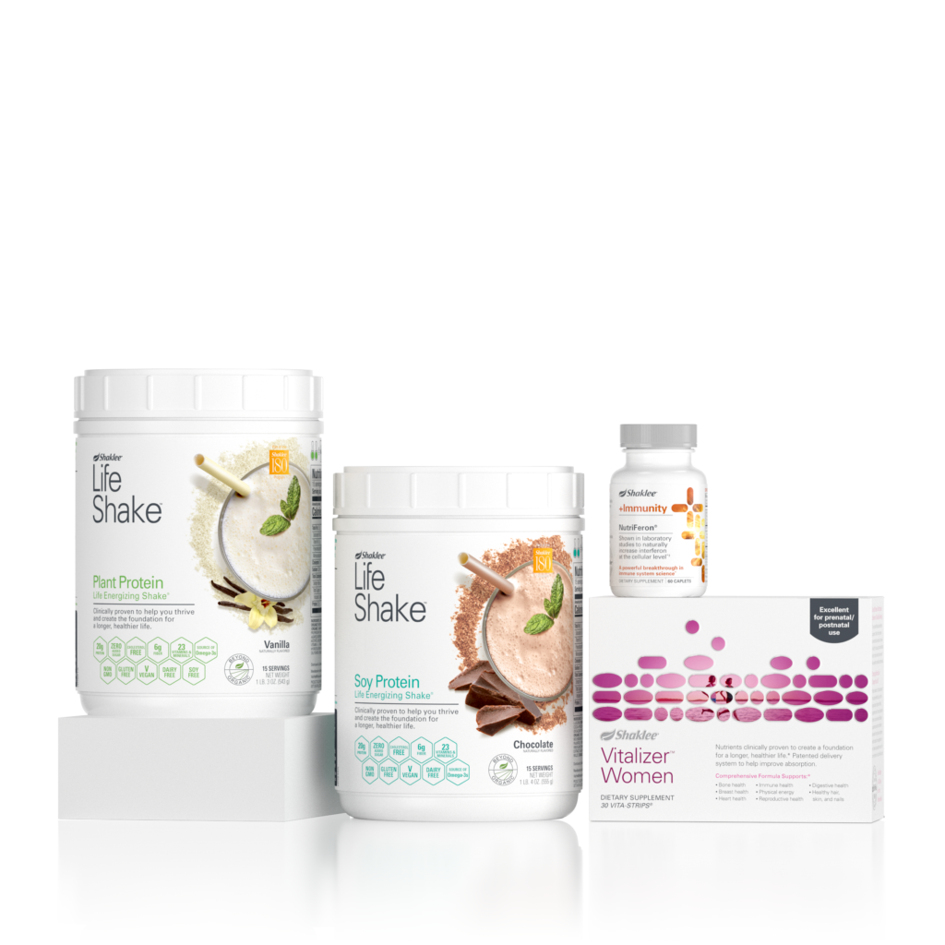
Immunity Challenge Kit
Includes 30 Vitalizer Strips,
30 Life Shakes and a FREE bottle of NutriFeron.
#89549 | SPECIAL PRICE $159 Includes Free Shipping and Free Shaklee Membership.
First Time Purchase Only.
P

Slide 14
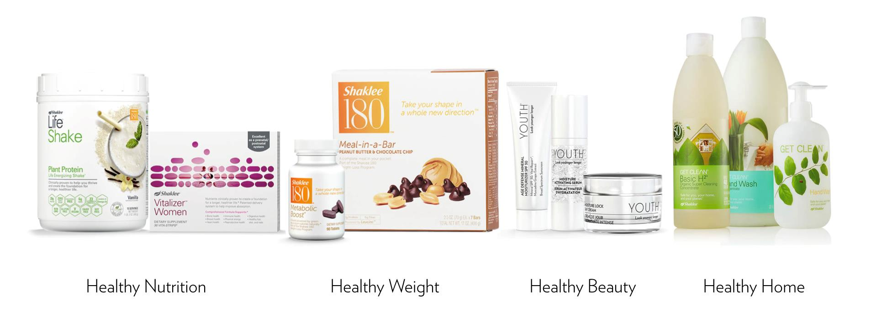
Shaklee offers everything you need to live a clean, healthier life…
P

Slide 15
Feel Amazing in just 30 days — guaranteed
You’ll Feel:
Healthier
More energized
More focused and ready for anything!
And We Prove It
M

Slide 16
I proved it– now I get paid for it
M

Slide 17
Sharing a little…can lead to a lot
M

Slide 18
P

Slide 19
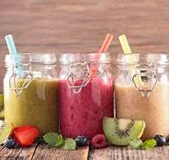
SHAKLEE SMOOTHIE WORKSHOP SPECIALS
Purchase $75 & receive a free gift
Purchase $150 & receive FREE shipping (+ free Shaklee membership)
Everyone in attendance receives FREE smoothie recipes.
M
Notes:
Vita D3 is so helpful for mood but also a great immunity builder. It is also needed for healthy cell development, not to mention strong bones and teeth.
We will be sending the recipe sheet after we are finished zooming. Free membership w/ and order over $150, over $200 you get the Organic Greens Booster.

Slide 20
M

